Slide 1
SEMESTER-8 BE MAJOR PROJECT REVIEW-I
WASTE MANAGEMENT SYSTEM
A840- Aryan Jain
A841- Dhruv Jain
A842- Naitik Jain
Guide: Prof. Sunil Khachane (HOD)
Expert: Prof. Bhushan Patil

Slide 2
introduction
Waste Management is a fundamental issue in all parts of the world. As the population is on the rise, waste and in turn pollution rises in both urban and rural settings. Most of the waste collected is dumped into landfills, which is rising, and is predicted to increase by 70 percent by 2025. With the emerging urban areas, there has been a steady increase in waste that is being dumped.
Improper disposal of waste harms the environment around us, leading to pollution, and many more hazards to air, water, soil and diseases. There has been a push for digitization of this, as technology is rapidly growing. To tackle this, we have proposed a system which will automate the work of distinguishing between different types of wastes, such as metals, plastics, paper and many more. Using Deep Learning, we plan on training a data set, which can then be used to identify the waste. This will be helpful is recycling of waste, as well as proper disposal of waste which is biodegradable, and thus help the environment, while being efficient.

Slide 3
ANALYSIS
The waste management system consists of only one service that is waste article classification. Here, waste is classified waste into six categories such as metal, paper, glass, trash, plastic, cardboard.
The data-set contains images of solid waste objects across 6 classes with about 100–500 images in each type of waste, totaling about around 2497 images.
Whatever the image is collected is re-sized or transform to suitable type which the algorithm can use for proper training.
For the pre-processing stage, data augmentation method was performed on the images, because of the small data size.
A convolution neural network (ConvNet or CNN) is one of the most popular algorithms for deep learning, a type of machine learning where a model learns to perform the task of classification directly from text, images, videos or sound.
Due to the fact that the trash image dataset is small, pre-trained ResNet-50 model is used which is a type of Convolutional Neural Network architecture

Slide 4
LITERATURE REVIEW
The accumulation of solid waste in the urban area is becoming a great concern, and it would result in environmental pollution and may be hazardous to human health if it is not properly managed.
An advanced classification system is developed using Convolutional Neural Network (CNN) model that is using deep learning which is used to classify variety of waste materials into different groups/types such as glass, metal, paper, and plastic, etc.
The idea behind all the projects was to classify all the waste material into different categories and minimize the human effort and develop an automated system which will classify waste accurately and efficiency.
Many different algorithms have been developed for the classification of images, such has RNNs, SVMs, ANN etc, but Convolutional Neural Network which is a Machine Learning algorithm has really performed better than them all.
CNNs hit the spot when the algorithm was used to win the 2012 image-Net large-scale visual recognition challenge (ILSVRC) which was proposed earlier. Since 2012 many different CNN architectures have been developed which has solved many image classification problems.

Slide 5
No. | TITLE | YEAR | AUTHOR | METHODOLOGY | FINDINGS | LIMITATIONS
1) | Automatic classification of solid waste using deep learning | Springer, 2020 | V. P. Brintha, R. Rekha, J. Nandhini, N. Sreekaarthick, B. Ishwaryaa, et al. | The proposed idea mainly concentrates on the classification and identification of the waste that is being dumped into the garbage. | The developed system could identify different types of wastes when shown individually with different accuracies. | The system is not able to classify waste accurately when the image contain more than one waste category.
2) | An automatic classification method for environment | IEEE,2016 | S.Sudha M.Vidhyalakshmi K.Pavithra K.Sangeetha | The implementation part is done using Caffe which is a deep learning framework as software. Deep learning and deep features have only recently achieved strong results in many tasks. | The developed system would pioneer the work for solid waste management process in the field of Artificial Intelligence. When properly trained, the system is highly efficient | It has very less accurate due to use of caffe.
3) | Intelligent waste classification system using deep learning CNN | SMPM,2019 | Olugboja Adedeji, Zenghui Wang | The proposed method is developed based on the ResNet-50 pre-trained model, SVM. | The proposed system is able to classify waste with 87%accuracy. | The model is trained using small dataset and thus accuracy was not optimal.
4) | Automation of Waste Sorting with Deep Learning | IEEE WVC,2019 | Joao Sousa , Ana Rebelo, Jaime S. Cardoso | Basic R-CNN, Hierarchical Approachs used using multi-labeled datasets and traininf for shape and materials | The direct R-CNN used gave a mAP of 74.1%, using a hierarchical approach gave a mAP of 80.9% for materials, and 86% for shapes showing improvement on R-CNN methods | It uses a non controlled data set which makes training difficult and the model is specifically trained for food trays.

Slide 6
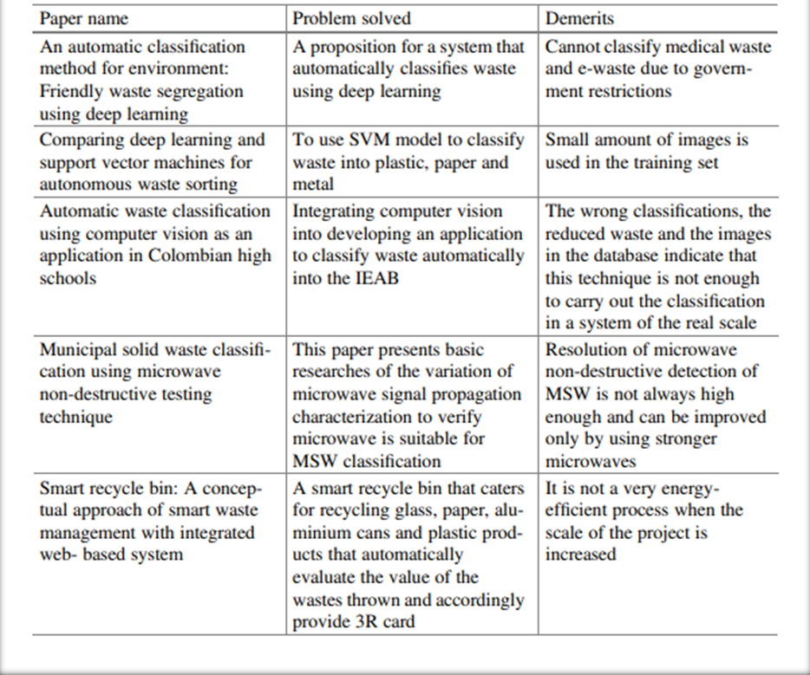
LITERATURE SURVEY

Slide 7
Problem Statement
The increasing population poses serious threats like limitation of living space, education and employment. But a major serious problem is the enormous amount of waste generation each minute. Waste management is a big challenge in urban areas for most of the countries throughout the world. An astounding ton of waste is generated on a daily basis, but only 5% of this large amount of waste is recycled.
A possible solution for this could be segregating the waste at the starting stage itself. The identification of the waste is to be properly managed so as to minimize the risks to the health and safety of patients, the public, and the environment. Currently there is no effective system for identification of various types of wastes at a household level. The purpose of our project is to make a simple, low cost and user-friendly waste management system for urban households to introduce waste management process more effective in India.

Slide 8
EXISTING SYSTEM
The existing systems of waste management system consists of only service that is waste classification which is primitive and not user friendly.
With the introduction of Machine Learning Algorithms, it has become easier for training models to detect and classify waste, and is being implemented slowly at industrial levels for sorting of waste at waste management plants, etc.
This is done by using Deep Learning algorithms such as Convolution Neural Networks and Recurrent Neural Networks. IoT operations such as high-speed cameras and robotic arms have also been used in industrial application of Waste Management.
The hardware components along with older and smaller datasets makes the process of Classification complex at a large scale.

Slide 9
PROPOSED SYSTEM
The proposed methodology mainly focuses on the identification and classification of the waste service provided for waste management.
The proposed idea of the project is to provide with an efficient and digital solution to this, so as to waste management through services provided by us.
This project all while being user friendly for the basic users of the system, allowing them to manage waste properly and efficiently through different services.
The waste management website consists information regarding waste management techniques and has following four services of waste management as follows:
1) Classification of waste article through ML model.(ResNet-50 Model)
2) Disposal and Recycle System.
3) Garbage Truck Monitoring System.
4) Garbage Level Monitoring System.

Slide 10

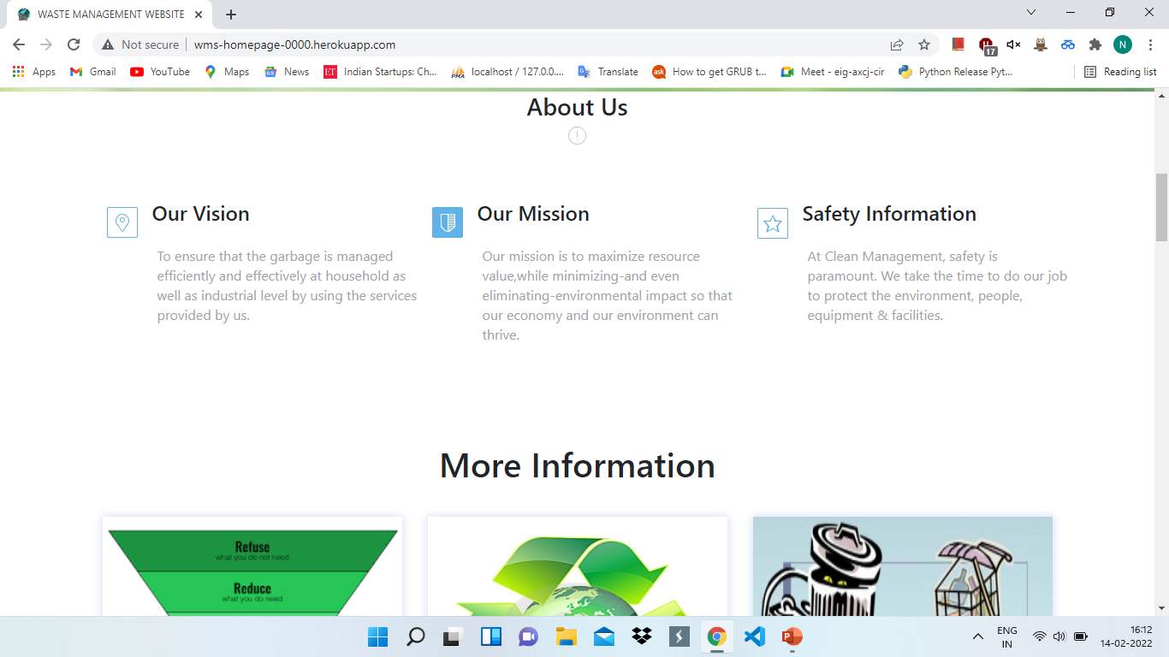
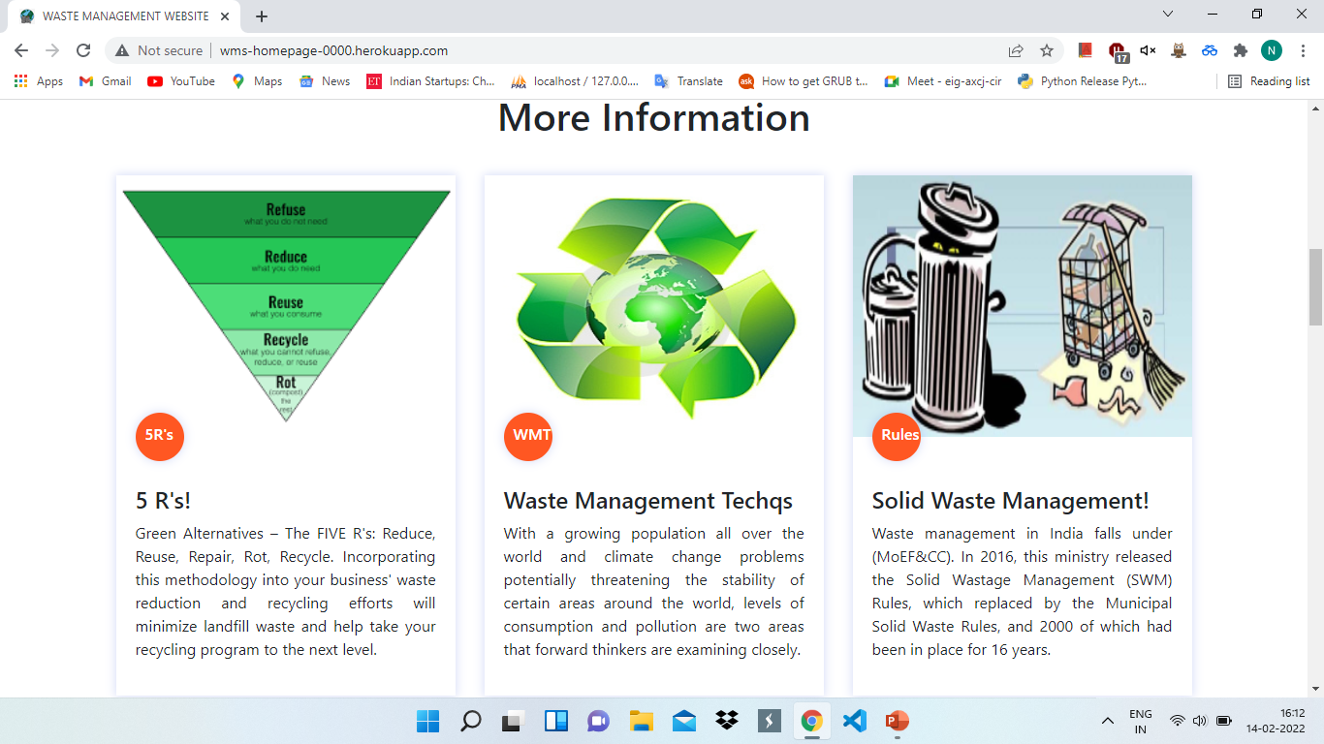
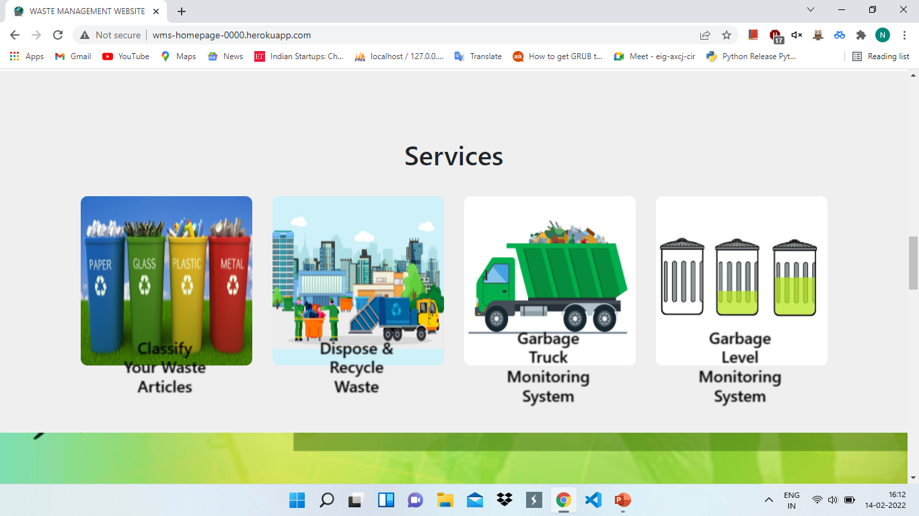
HOME PAGE OF OUR WEBSITE

Slide 11
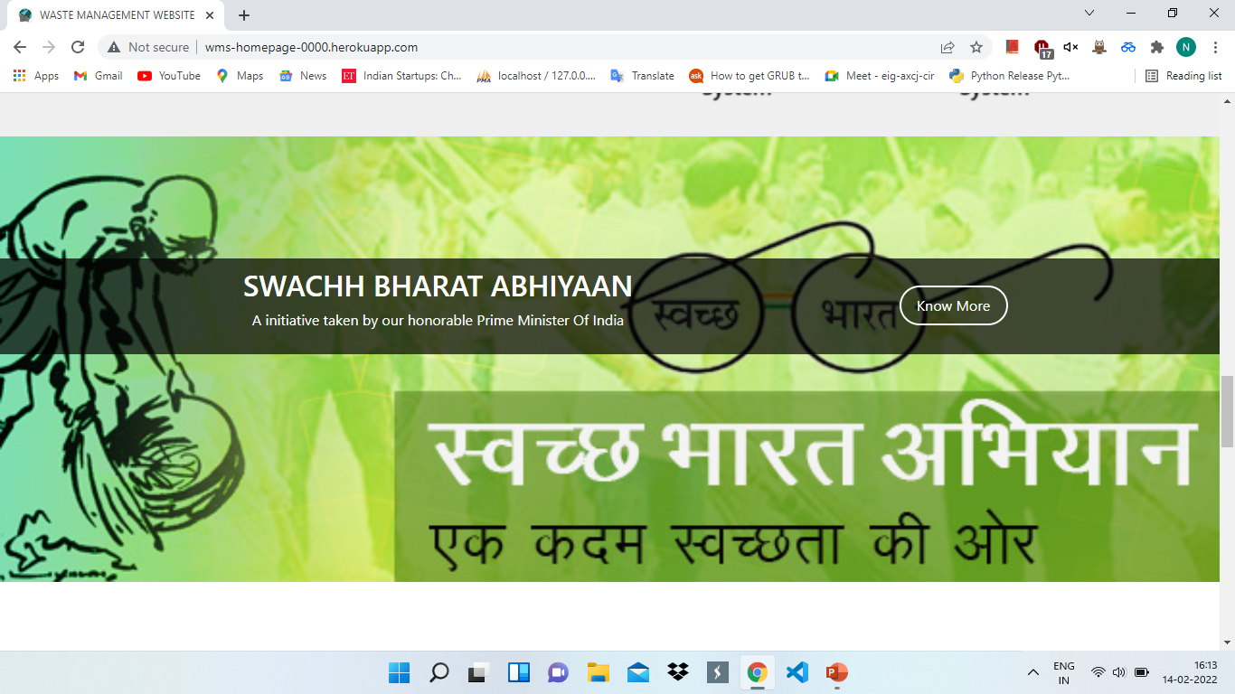
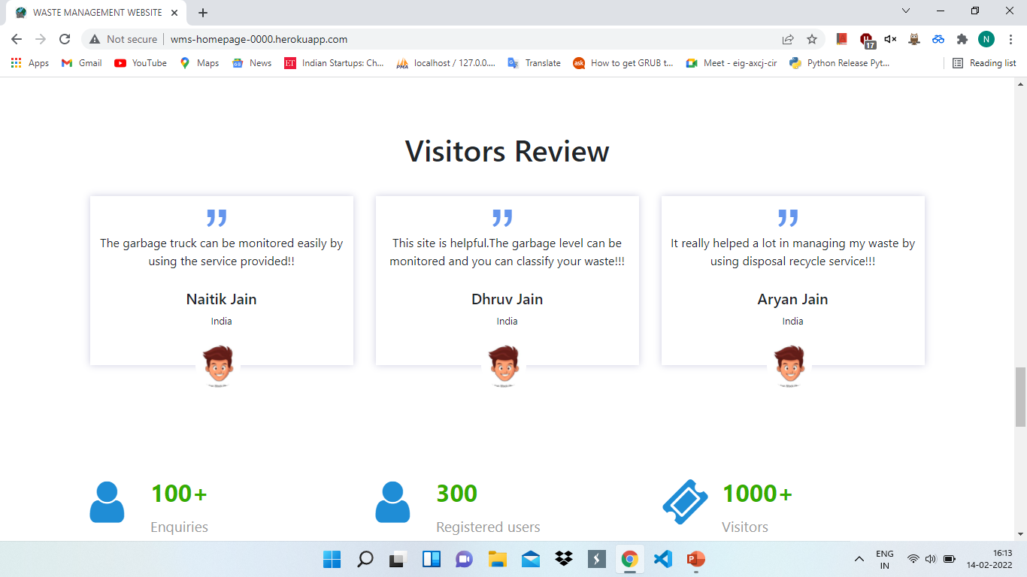
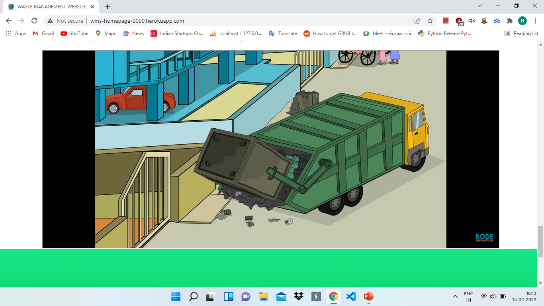

HOME PAGE OF OUR WEBSITE

Slide 12
SERVICES:-
1. WASTE CLASSIFICATION SYSTEM
2. DISPOSAL-RECYCLE SYSTEM
3. GARBAGE TRUCK MONITORING SYSTEM
4. GARBAGE LEVEL MONITORING SYSTEM

Slide 13
1. WASTE CLASSIFICATION SYSTEM
The waste management system consists of only one service that is waste article classification. Here, waste is classified waste into six categories such as metal, paper, glass, trash, plastic, cardboard.
The data-set contains images of solid waste objects across 6 classes with about 100–500 images in each type of waste, totaling about around 2497 images.
Whatever the image is collected is re-sized or transform to suitable type which the algorithm can use for proper training.
For the pre-processing stage, data augmentation method was performed on the images, because of the small data size.
A convolution neural network (ConvNet or CNN) is one of the most popular algorithms for deep learning, a type of machine learning where a model learns to perform the task of classification directly from text, images, videos or sound.
When the prediction output is displayed , it also display info regarding prediction along with some video relevant to the context.

Slide 14
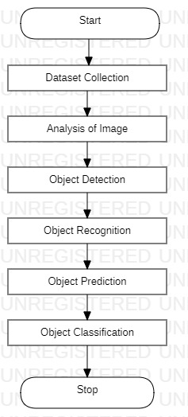
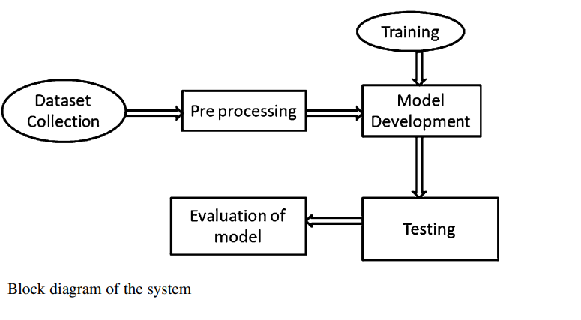
SYSTEM ARCHITECTURE & Basic Flow of Image Classifier

Slide 15
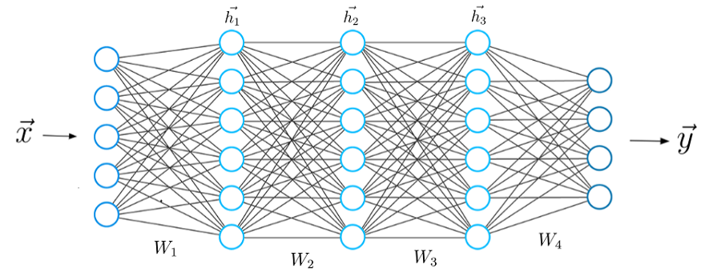
REQUIRED ALGORITHMS
DEEP LEARNING ALGORITHMS:
CONVOLUTIONAL NEURAL NETWORK (CNN):
A convolution neural network (ConvNet or CNN) is one of the most popular algorithms for deep learning, a type of machine learning where a model learns to perform the task of classification directly from text, images, videos or sound. CNNs are specifically useful for finding the patterns in images to detect and recognize objects, faces and poses

Slide 16
ResNet-50:
Due to the fact that the trash image dataset is small, we used a pre-trained ResNet-50 model which is a type of Convolutional Neural Network architecture. When the depth is increased, the recognition accuracy of the convolutional neural network can be increased, but due to the increase in depth, the signal that is supposed to modify the weight is reduced at the earlier layer of the CNN.
This will make learning at the earlier layers inconsequentially and this is called vanishing gradient. Adding more and more layers to the network always leads to training error.
Residual Network (ResNet-50) is different from the normal convolutional Neural network in that, it is able to go around this problem of vanishing gradient by designing the Convolutional neural network using modules which are called residual models, the ResNet model.

Slide 17
DATASET FOR TRAINING
Our dataset includes images of different categories of waste such as cardboard images, paper, plastic, metal, glass, other trash images,etc
This includes:
Cardboard:- 403 images
Glass :- 501 images
Metal:- 410 images
Paper:- 594 images
Plastic :- 492 images
Other Trash:- 137 images
Total around:- approximately 2500 images

Slide 18
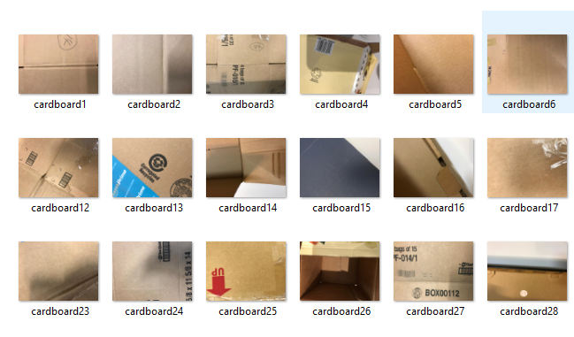
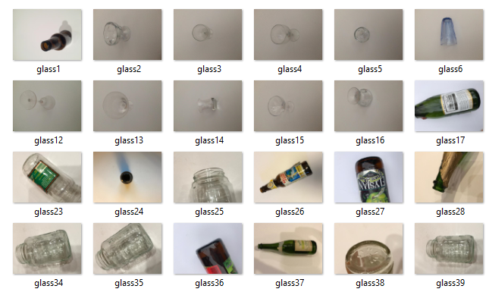
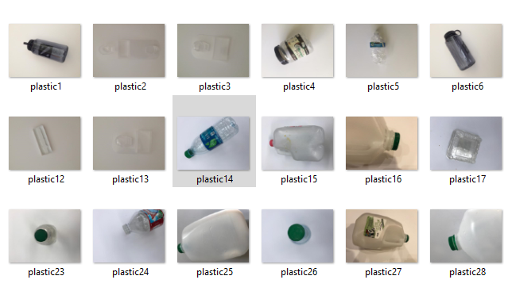
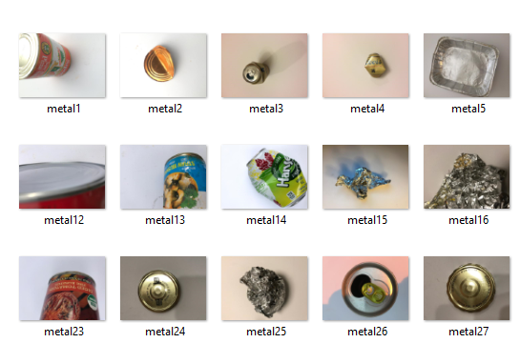
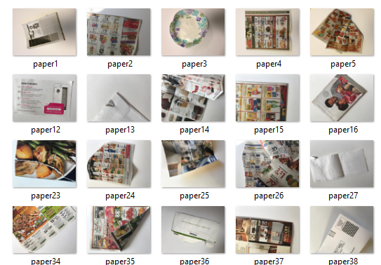
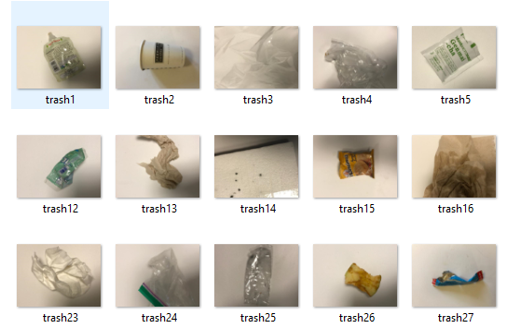
IMAGES FROM DATASET FOR CLASSSIFICATION

Slide 19
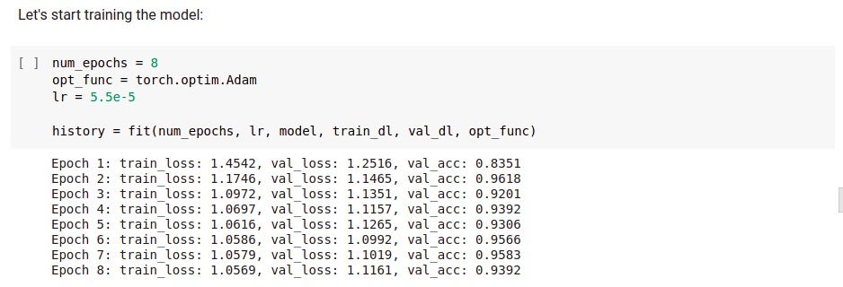
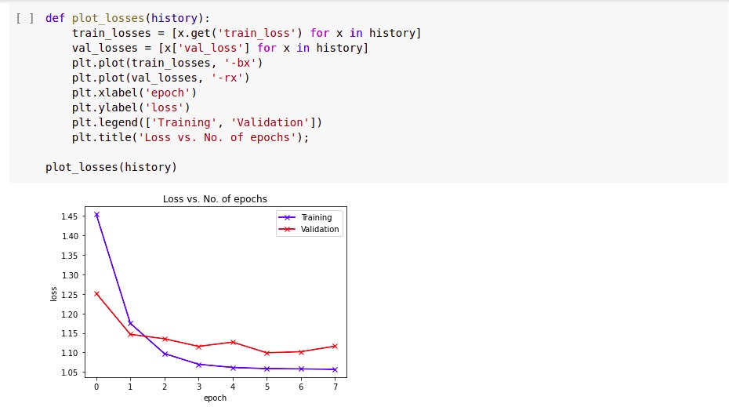
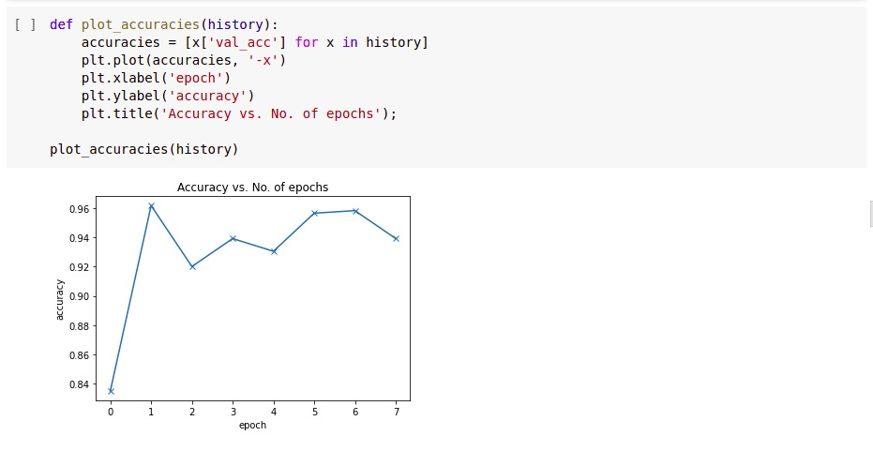
Implementation OF CLASSIFICATION MODEL

Slide 20
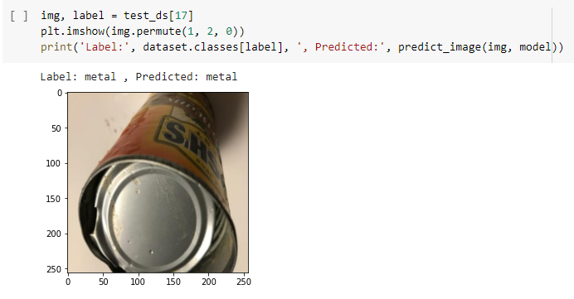
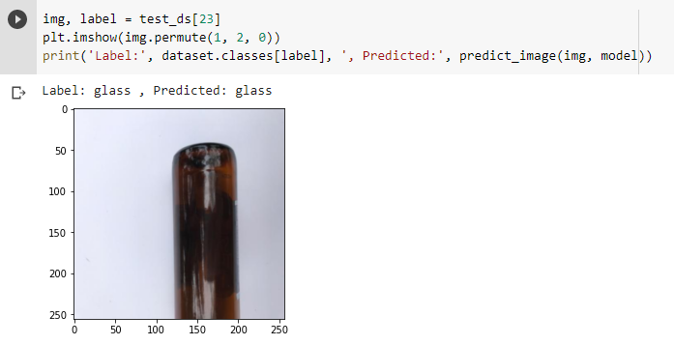
PREDICTION OUTPUT OF MODEL IN COLAB

Slide 21
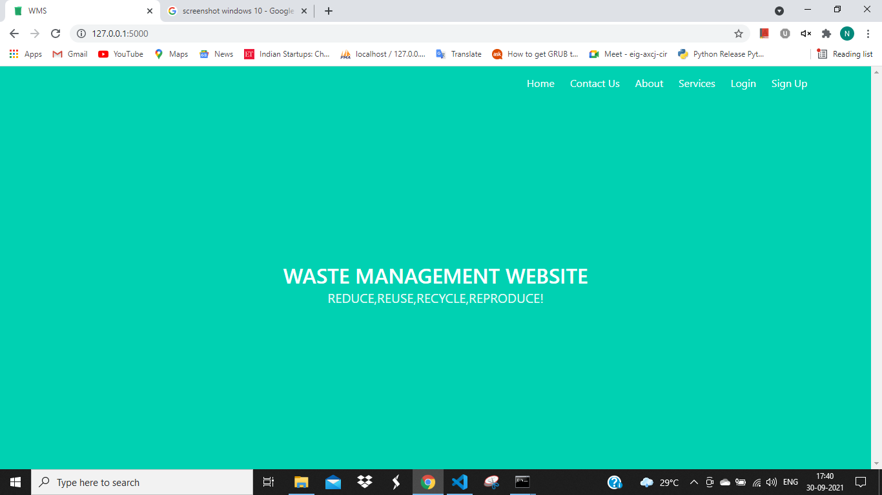
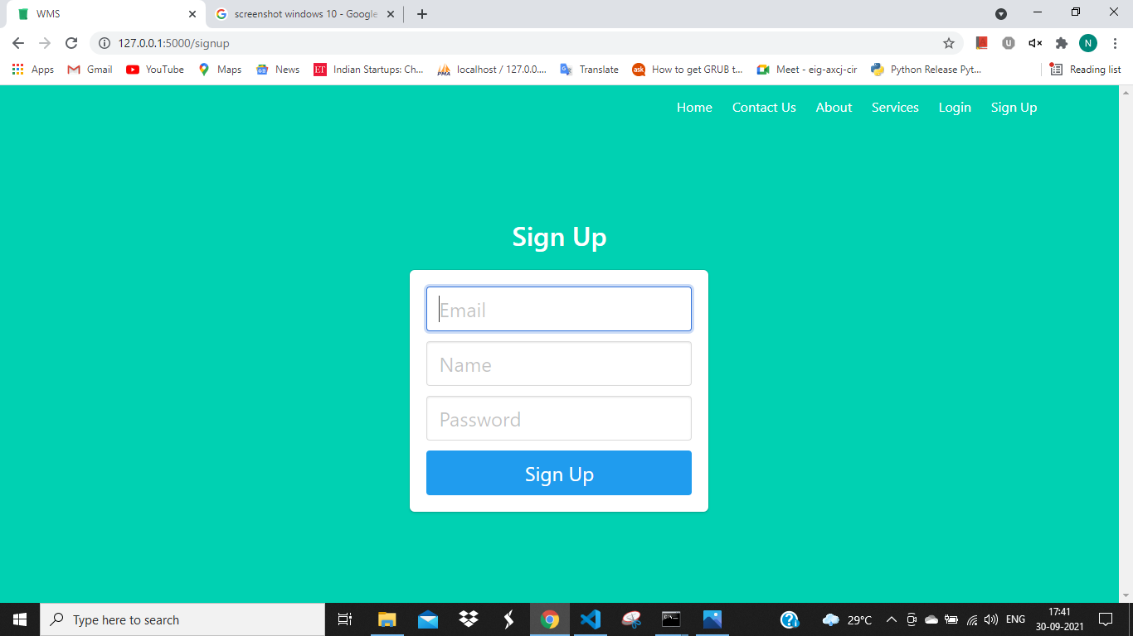
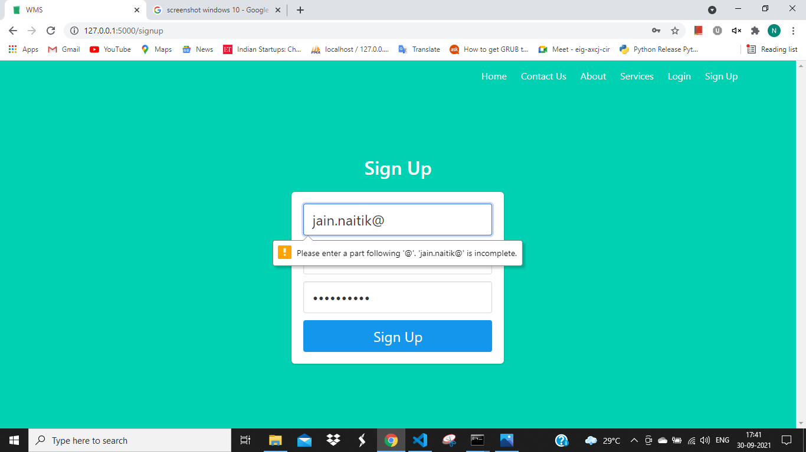
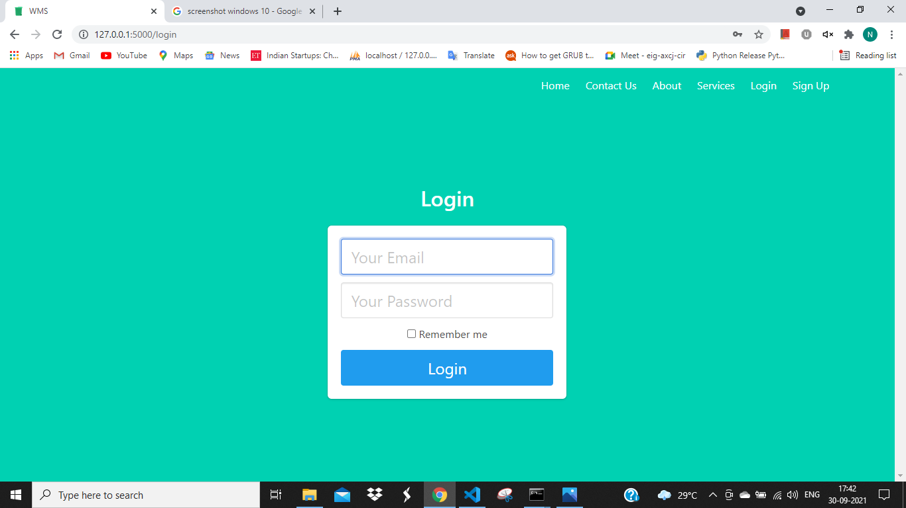
Screenshots

Slide 22
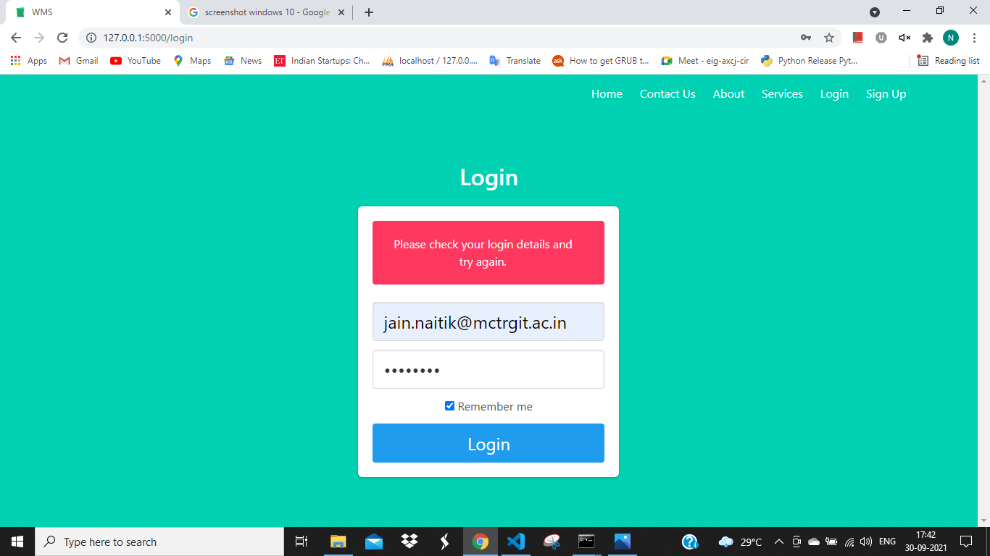

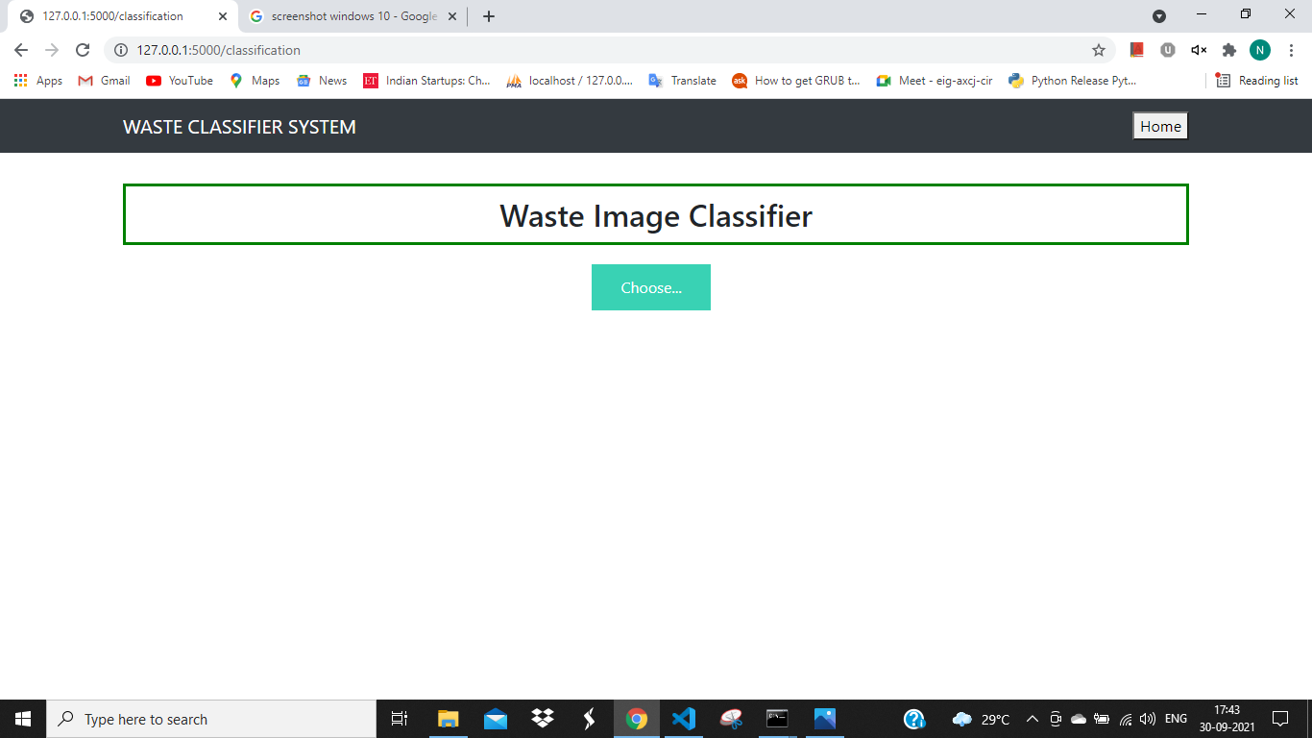
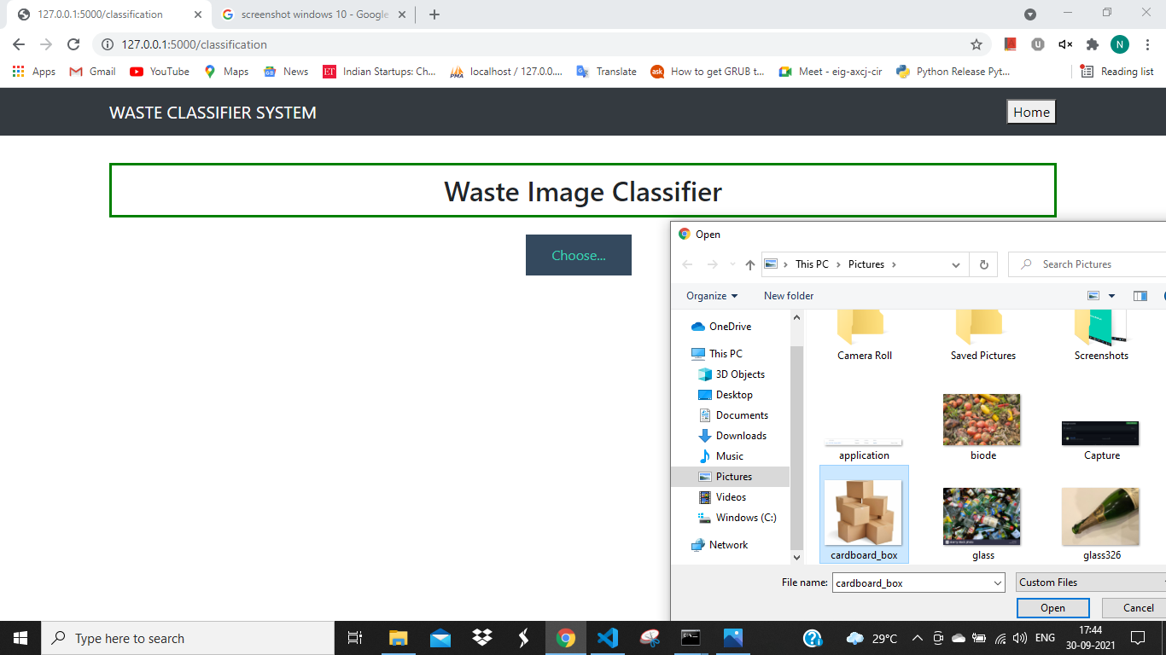
SCREENSHOTS

Slide 23
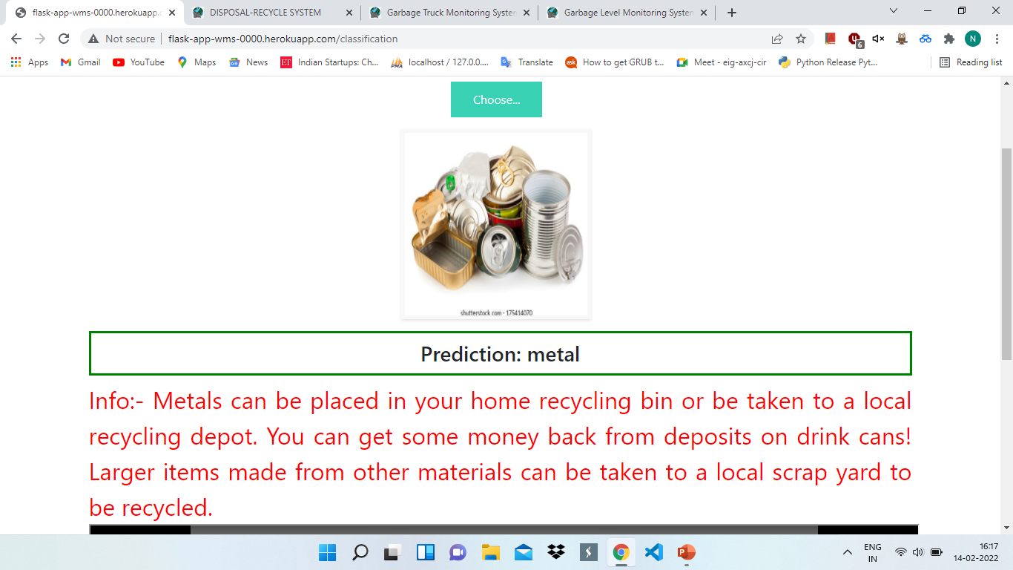
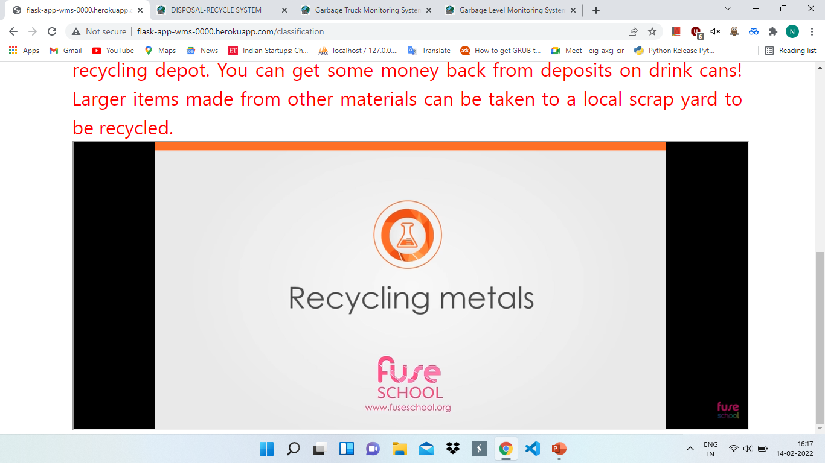
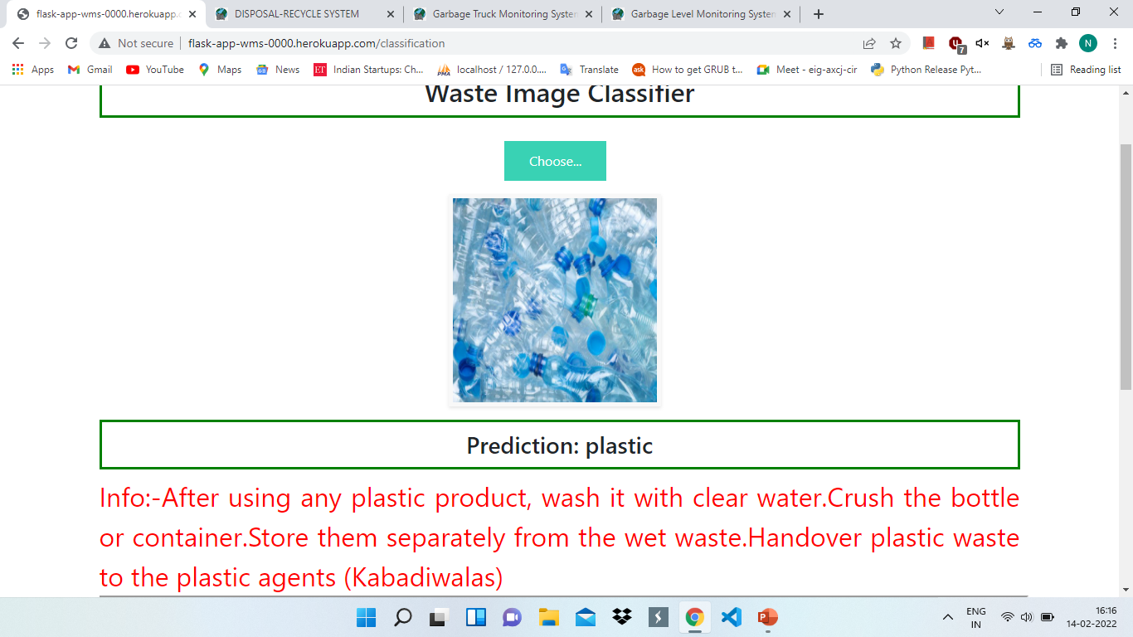
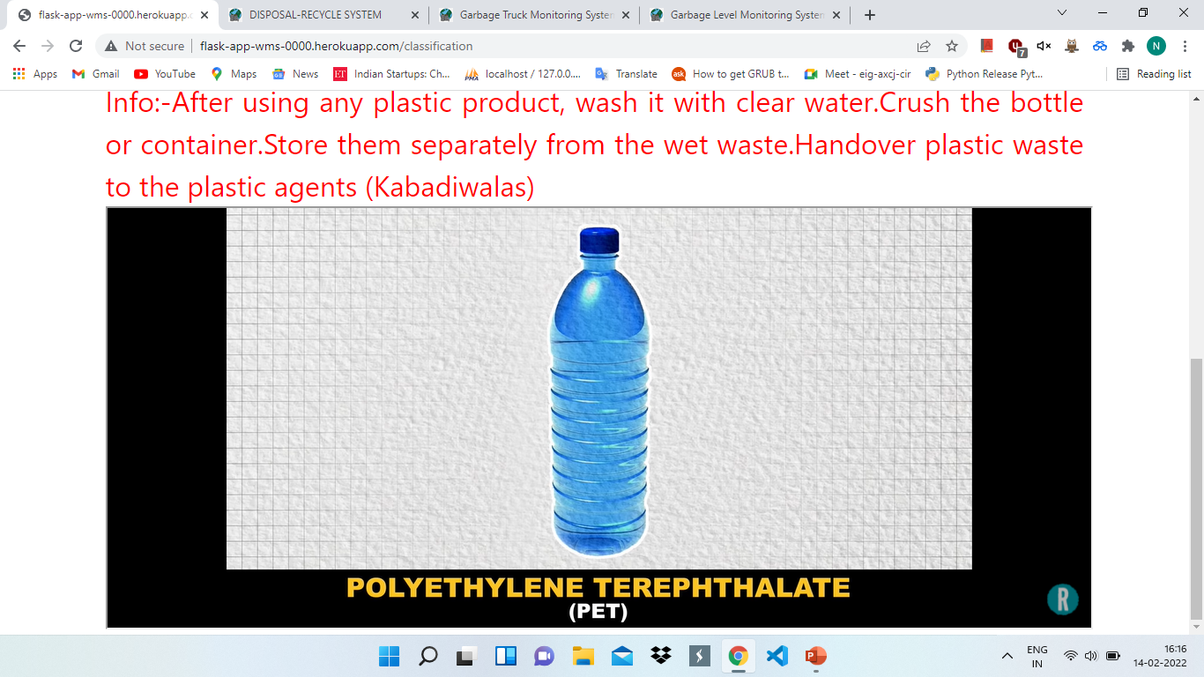
SCREENSHOTS

Slide 24
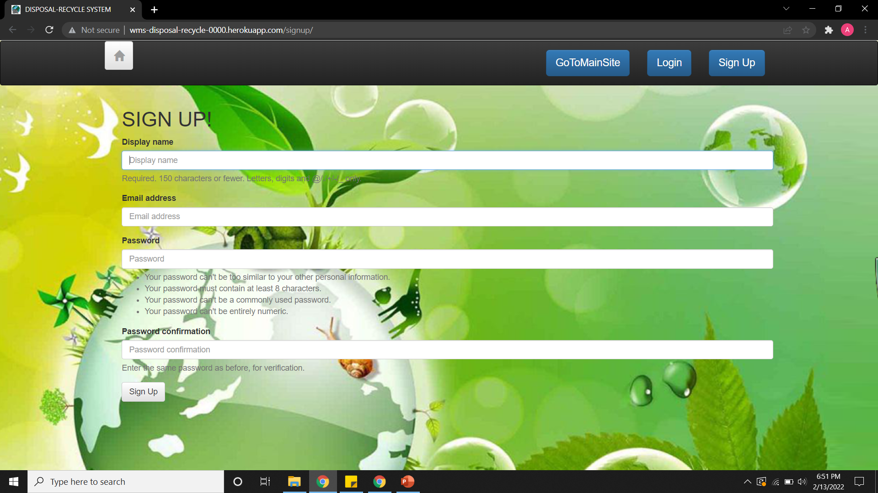
2. DISPOSAL RECYCLE SYSTEM
The purpose of the system is to collection of waste from the user. The waste collected is divided in 5 Categories : Paper, Plastic, Organic, Glass, Metal. The users can submit the information regarding their waste so that it can be located by the recycler so as for collection.
Utilization of Waste : The company now, uses the waste by amicably collecting it, profusely processing it and efficiently recycling it.

Slide 25
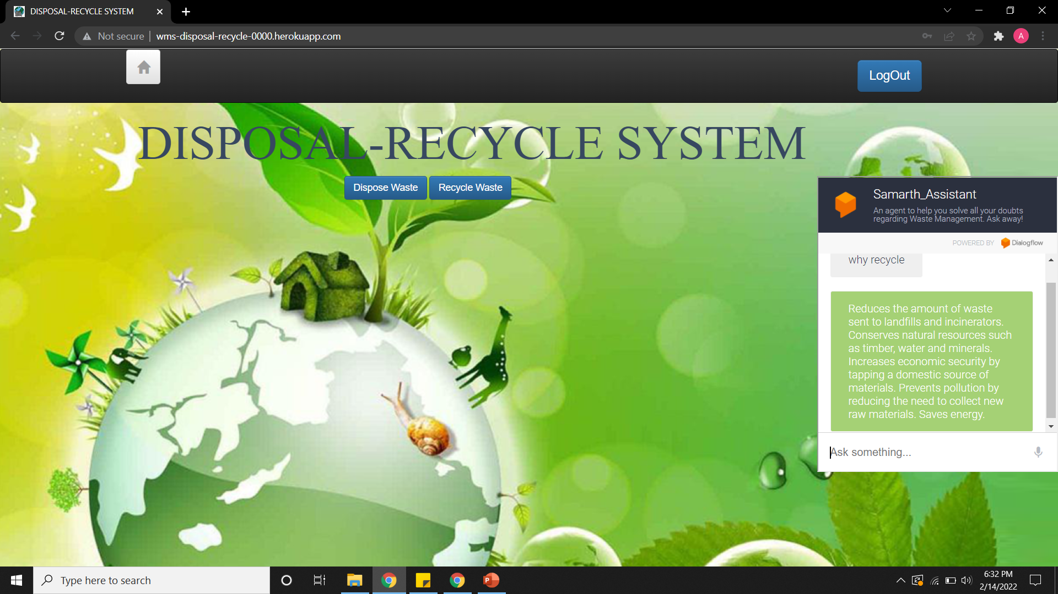
Home page with chatbot
Here our home page consists of Dispose and Recycle options, where the user can dispose or request waste.
Along with this, we have also integrated a Chatbot which can help the user with basic queries.

Slide 26
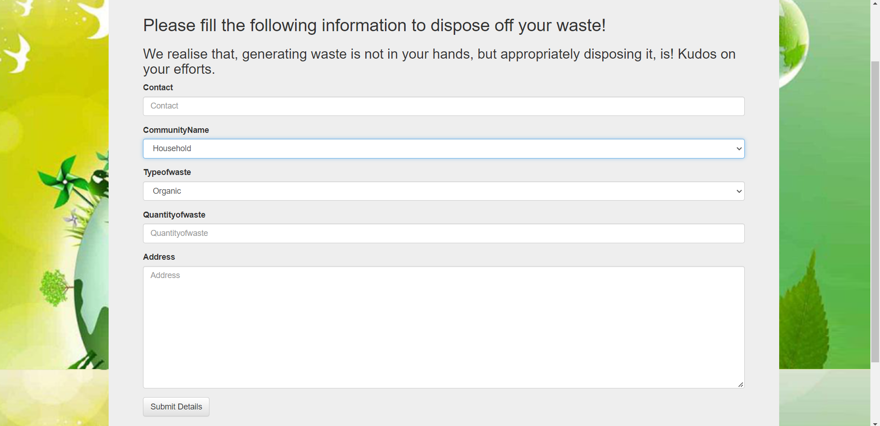
Disposal FEATURE
Here the user can fill out the information regarding the waste they have present to dispose off.
This data is then stored in the database, where the collector can fetch it from.

Slide 27
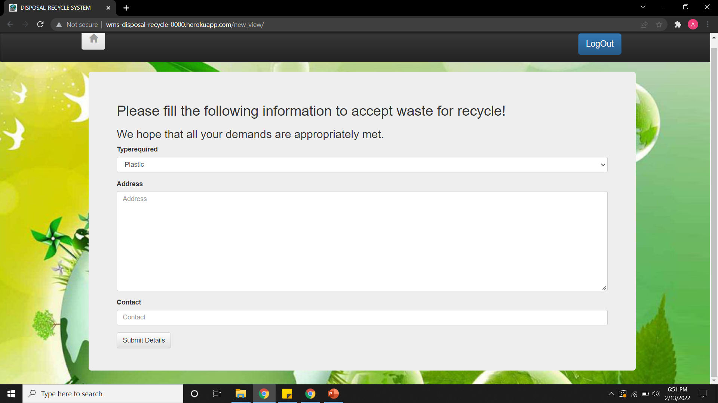
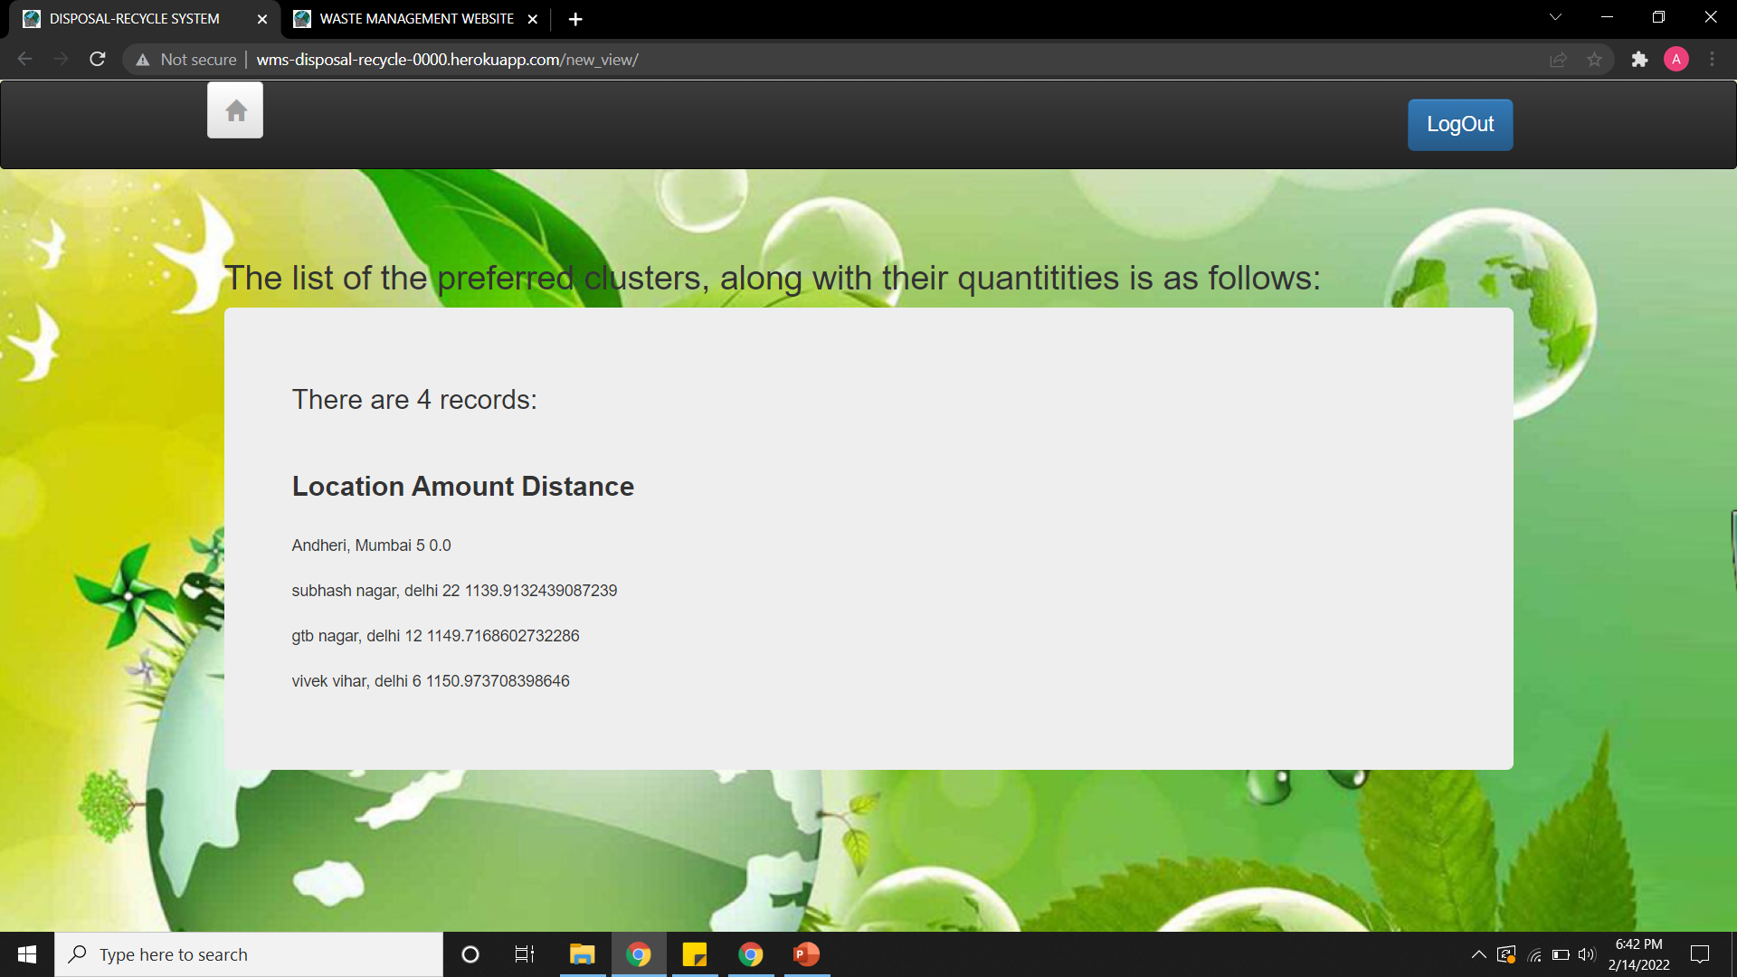
Recycle Option
The collectors of waste can use this feature to know about the waste which they can procure.
They can fill in the information, and then they will get results about the type of waste, the amount of waste and the distance.

Slide 28
3. GARBAGE TRUCK MONITORING SYSTEM
Garbage Truck Monitoring System is a web based application service which is used for automatic smart route generation for day-to-day garbage collection which minimizes the fuel consumption of garbage trucks by providing systematic routes on the basis of real time percentage level of garbage in the bins, capacity of trucks, road feasibility.
Garbage Truck Monitoring System is a role based system having three roles admin, driver and a citizen. Admin has a dashboard from which admin can add resources such as drivers, bins, depot, dumping ground and vehicles. Admin will have facility of viewing the current data in the system and monitor the drivers in real time.

Slide 29
FEATURES OF GTMS
1) Add resources
2) Add Driver
3) Add Bin
4) Add Depot
5) Add Dumping Ground
6)Add Vehicle
7)Generate Routes
8)Real Time Monitoring
9)Status Of Bins
10) View Data

Slide 30
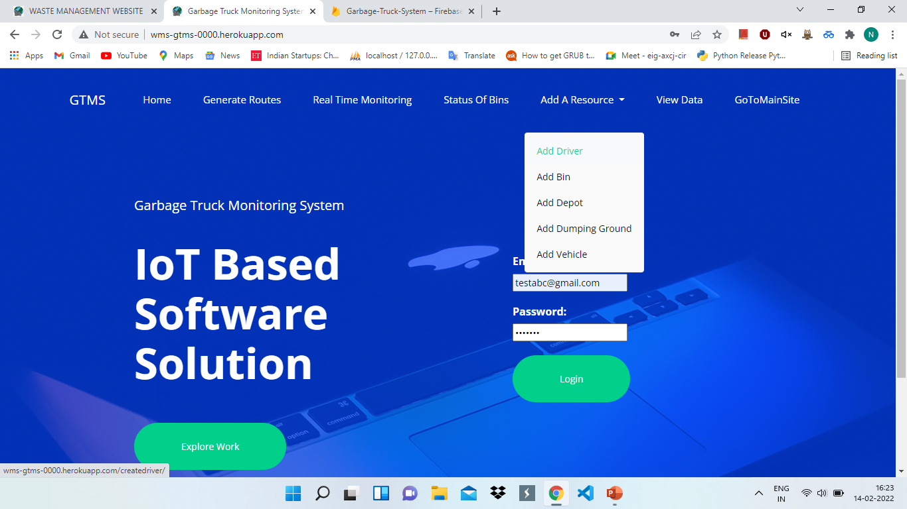
INDEX PAGE

Slide 31
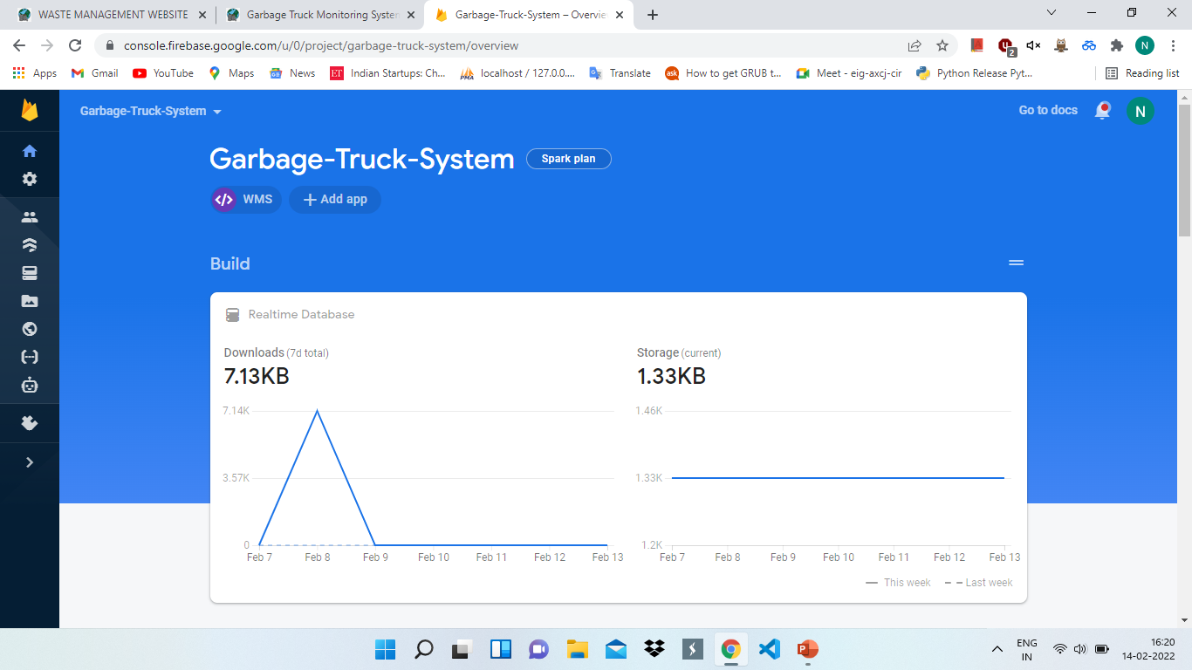
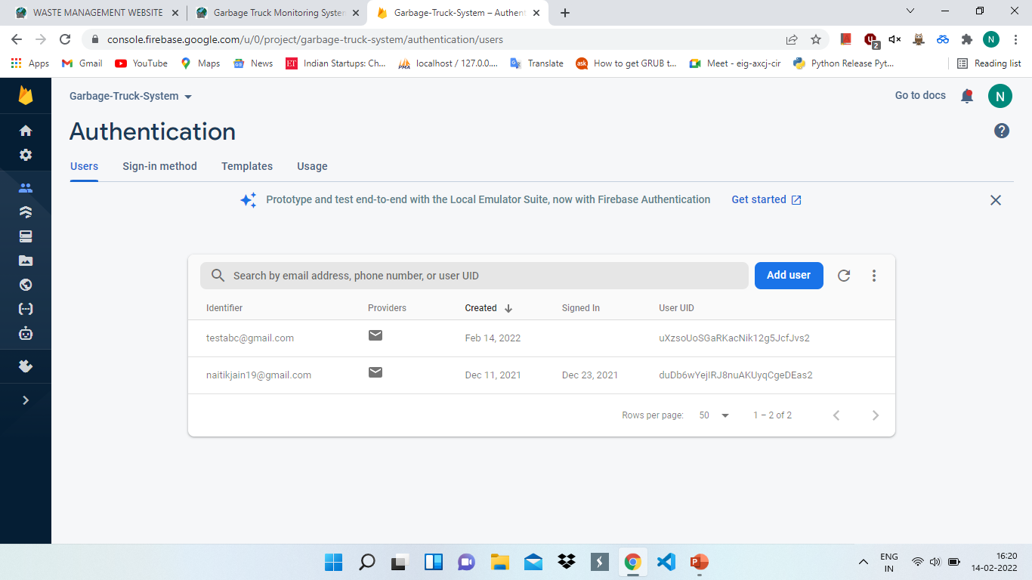
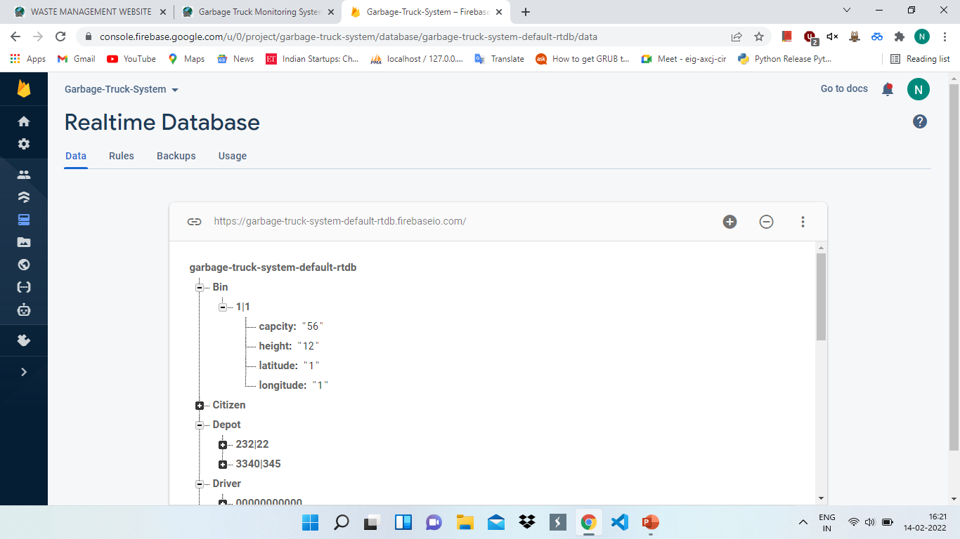
FIREBASE DATABASE

Slide 32
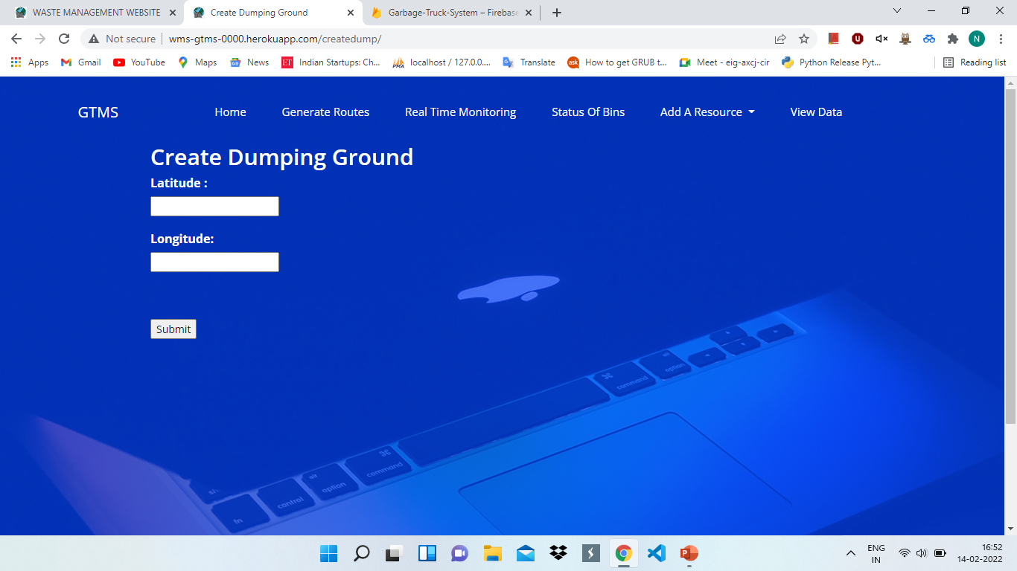
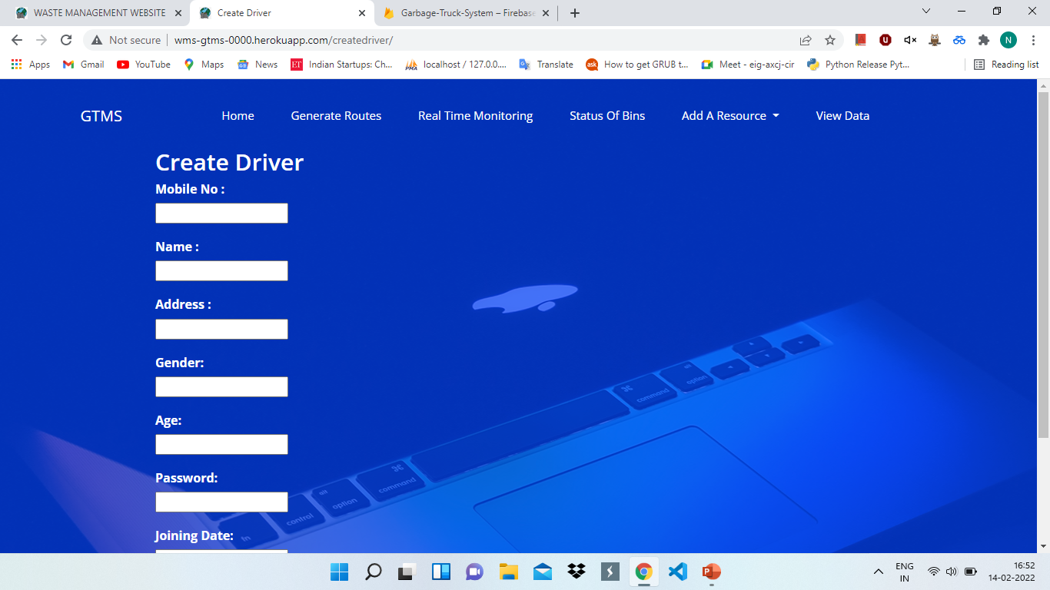
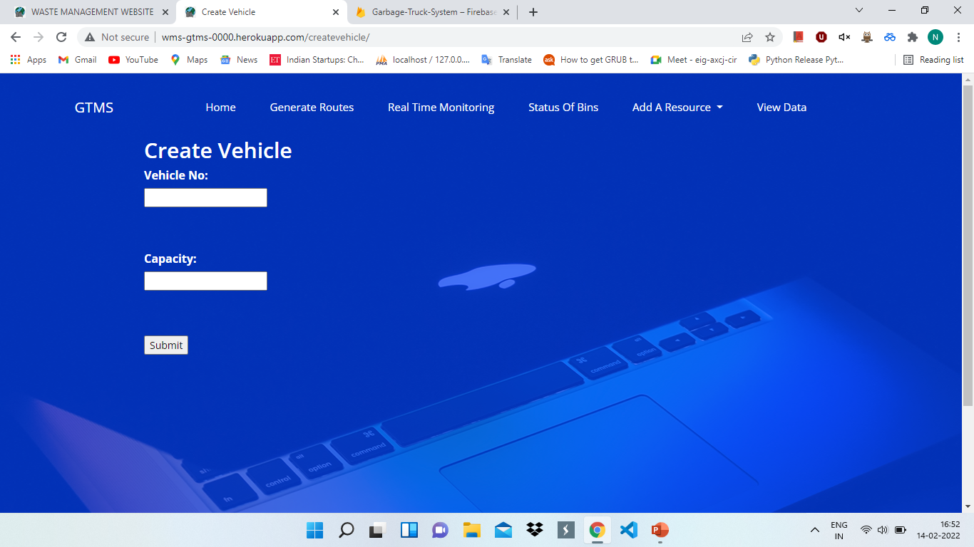
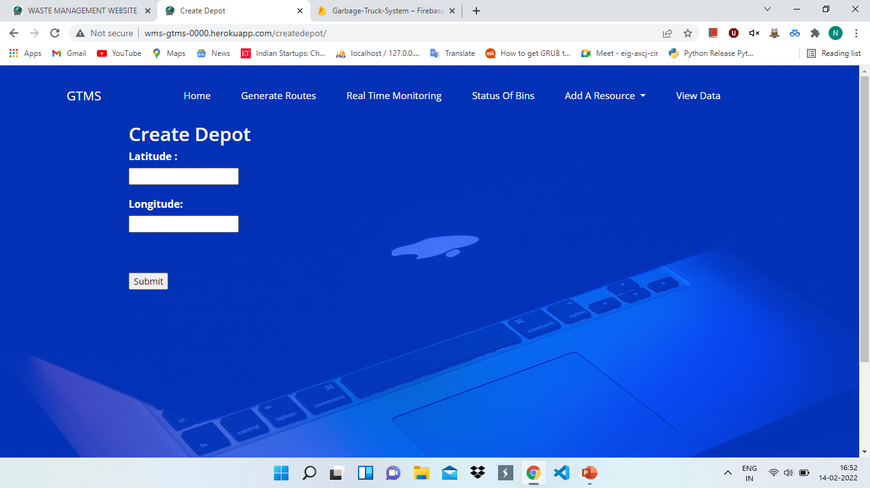
Create Driver, DEPOT, VEHICLE, Dump

Slide 33
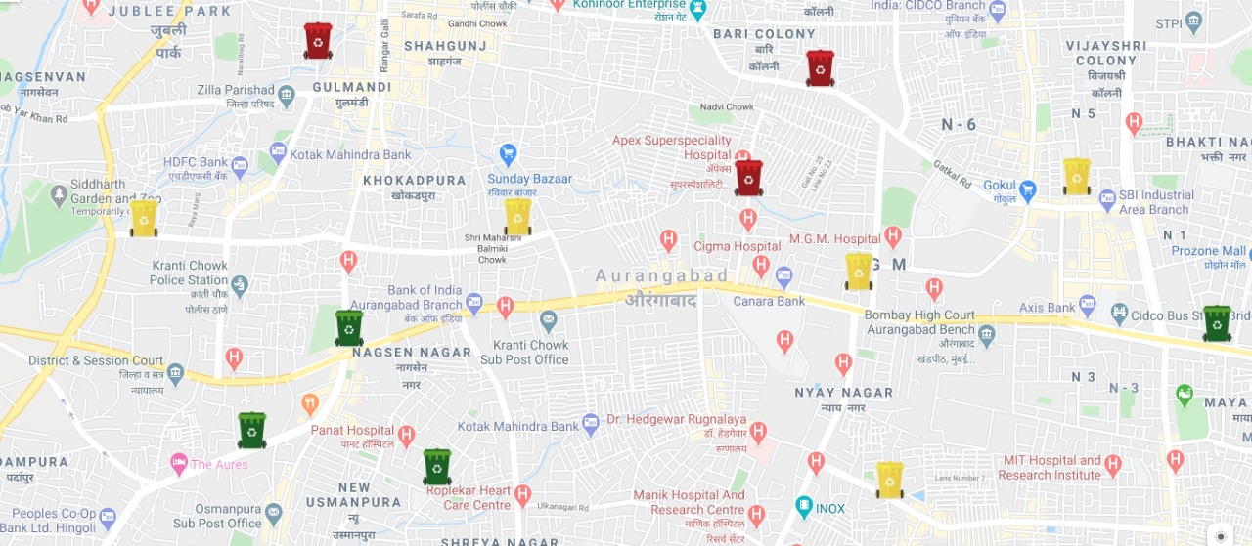
STATUS OF BINS
The bin status will be shown to admin wherein bins are classified into three categories based on the level of garbage. Red, yellow and green bins represent overfilled bin, normally filled bin and underfilled bin respectively.

Slide 34
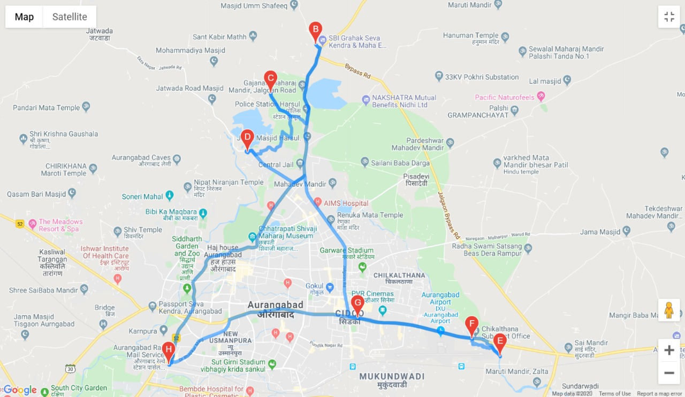
GENERATE ROUTES
The routes will be generated using our algorithm which follows the approach followed by CVRP algorithm. Daily, routes will be generated taking into account the real time garbage level, capacity of vehicles, the distance between bins, etc. G Maps API provides an efficient way and real time distances according to the traffic parameter for the inputs.

Slide 35
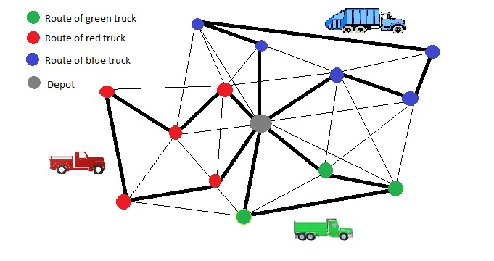
The visualization of CVRP is given as follows.

Slide 36
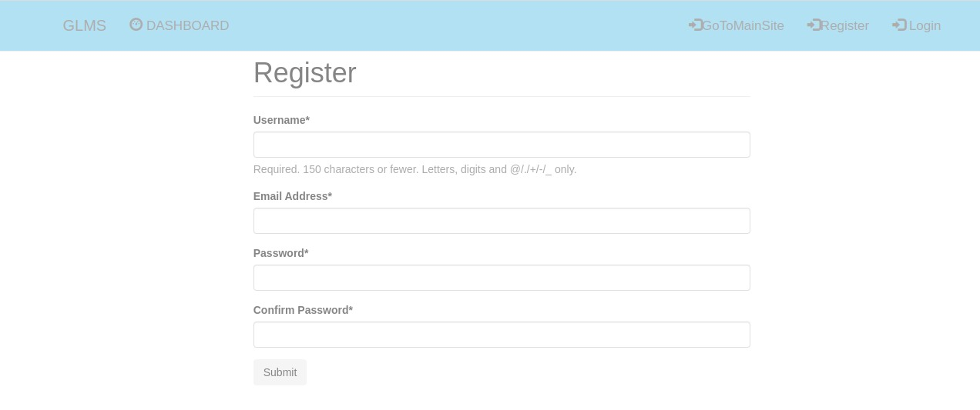
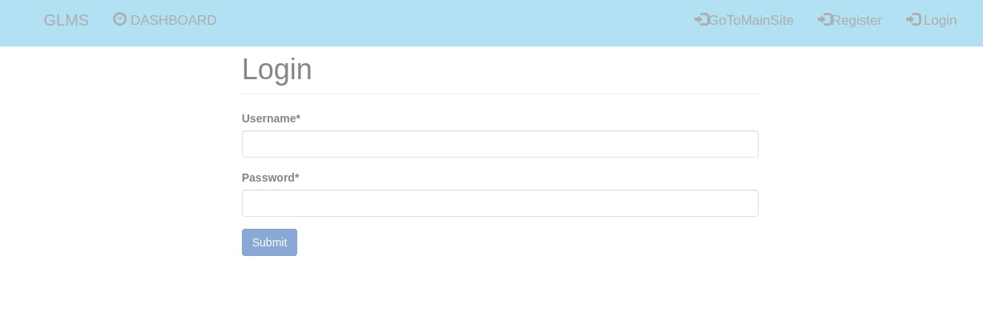
4. Garbage Level Monitoring System
It is the application which will help municipalities to track the garbage level in particular Dustbin.
It will shows how much percent dustbin is filled in circular progress bar.
The page will refresh every 10 sec, that mean we are getting live tracking of Dustbin.
We can even find location of each dustbin by clicking on it

Slide 37

Garbage level of different dustbin

Slide 38

Status of specific Dustbin

Slide 39
Project Development
Hardware Requirements
Deep learning is a very CPU intensive thing to be running. Here are some system requirements to adhere to:
Quad core Intel Core i5 8th Generation or higher (Dual core is not the best for this kind of work, but manageable)
8GB of RAM or higher.
Minimum of 50GB of storage free
Premium graphics cards, with Nvidia GTX 980 or higher
Software Requirements
Python 3.7 or higher versions
Jupyter Notebook/Google-Colab
TensorFlow
PyTorch
OpenCV
IDE/Text-Editors
Other Python Libraries
Frameworks like FLASK, Django, front end languages like HTML,CSS,JS ,MYSQL,etc.
Platform | Hardware | Operating System | Supported Versions
Windows/Linux | Intel/AMD 64-bit | Windows | 10/Ubuntu -18.04

Slide 40
PROGRESS So FAR…..
So, after successfully creating our classification model using deep learning algorithm called CNN and using ResNet50 model to classify different waste articles, now we are trying to improve our classification model or classifier by collecting more images of waste articles so that it can predict the waste category more accurately.
Besides collecting images, we have started to deploy our classification model on a web-based application using python framework called Flask which is full stack framework for web development.
We have successfully created an authentication system for our website so that the user can register and login/logout in into our site to use our classifier for waste classification.
Also, we have created a web page for our classifier and in that we have started writing down the backend code to use our feature to upload an image by the user and to predict the result based on the waste category. The following slides contain screenshots of our site.
Also, we have added other services such as Disposal-Recycle System, Garbage Truck Monitoring System, Garbage Level Monitoring System each of having authentication system so as to manage the data of each service separately. We have also deployed our website on Heroku so that anyone can view our website anytime, anywhere via internet.

Slide 41
PLAN AHEAD
We have deployed our classification model which is one of the services on a web-based application using python framework such as flask or similar technologies.
We have also provide an authentication system as register/login/logout in each of our services so that user can login any-time and use our services conveniently.
Thus, we have almost achieved the aim of our project such as to provide an user-friendly/interactive system for our users and use different services for waste management.
We have started collecting information regarding to write IEEE technical paper and also to document our project in our report.
Thus, after Review-1, we aim to write the IEEE paper and complete our project report as soon as possible.

Slide 42
CORE TECHNICAL PAPERS
A. 2016 IEEE International Conference on Technological Innovations in ICT For Agriculture and Rural Development (TIAR 2016) 978-1-5090-0615-1/16/$31.00
©2016 IEEE 65 AN AUTOMATIC CLASSIFICATION METHOD FOR ENVIRONMENT FRIENDLY WASTE SEGREGATION USING DEEP LEARNING
https://ieeexplore.ieee.org/document/7801215/
B. Chapter 83 Automatic Classification of Solid Waste Using Deep Learning V. P. Brintha, R. Rekha, J. Nandhini, N. Sreekaarthick, B. Ishwaryaa, and R. Rahul
© Springer Nature Switzerland AG 2020 L. Ashok Kumar et al. (eds.), Proceedings of International Conference on Artificial Intelligence, Smart Grid and Smart City Applications,
https://link.springer.com/chapter/10.1007%2F978-3-030-24051-6_83
https://ieeexplore.ieee.org/document/8876924

Slide 43
OTHER TECHNICAL PAPERS
Automatic classification of solid waste using deep learning, Springer, 2020
V. P. Brintha, R. Rekha, J. Nandhini, N. Sreekaarthick, B. Ishwaryaa, et al.
An automatic classification method for environment, IEEE,2016
S.Sudha M.Vidhyalakshmi ,K.Pavithra ,K.Sangeetha
Intelligent waste classification system using deep learning CNN, SMPM,2019
Olugboja Adedeji, Zenghui Wang
Automation of Waste Sorting with Deep Learning , IEEE WVC,2019,
Joao Sousa , Ana Rebelo, Jaime S. Cardoso

Slide 44
Conclusion/FUTURE SCOPE
This kind of system is a step forward to make the existing system of waste management system easier by using technology. It is an efficient system which saves time, and due to it being automated, it provides a quick and easy solution.
The classification of trash into various recycling categories is possible through machine learning and computer vision algorithms.
Other services such as disposal-recycle system, garbage truck monitoring system, garbage level monitoring system when used as a combination of hardware such as IoT (Internet of Things) and software can help in improving the waste management techniques efficient and more better in future.
Thus, this kind of system can bring a revolutionary change in improving waste management across the globe and thus making our lives better for future generations.

Slide 45
THANK YOU

